Slide 1


Road Map for a New
TRU Budget Methodology
Town Hall – May 15, 2014

Slide 2
TODAY’S DISCUSSION
Introductions and Acknowledgements
ACT 1: Context Setting – TRU Numbers
ACT 2: Proposed Budget Methodology
ACT 3: Question Period
Notes:
Introduce Paul, Dina and Analjit
Acknowledge BMRSA Sub-Committee
Acknowledge feedback from consultations with BCOS, the Deans, TRUSU, the Board, the Senate and various community members who have submitted their ideas or comments – all leads to making the process more robust
Acknowledge work of Finance and MarComm in the production of the data and the deck
Context Setting:
While the presentation has evolved since we first did it in January, I decided to add a contextual piece to the front end. So before we get to the guts of the proposed budget methodology, I’d like to walk the community through some key facts and figures.
In this presentation, I’m gong to try not to take a specific position on any key issue. What I’m about to walk you through I do so without prejudice, spin or opinion for the most part. Some of the trends are interesting, some are surprising and some are as we’d expect them to be. This presentation will be available on the web afterwards so you’ll be free to go back and review the data as you see fit.
I’m doing this in the spirit of transparency and accountability and I think it’s a valuable exercise to go through as an institution so that going forward, we can have discussions that are fact based and accurate.

Slide 3
BUDGET MODEL REVIEW AND STRATEGIC ALIGNMENT
(BMRSA) – SUB-COMMITTEE OF BCOS WORK TO DATE:
Established Terms of Reference and membership
Establishment of Guiding Principles for a TRU Budget Methodology
Review of current budget methodology
Review of alternate budget methodologies
Review of TRU revenue sources
Examination of major cost drivers
Review of budget anomalies
Review of carry-forward process/impacts

Slide 4
SCHEDULED CONSULTATIONS:
Budget Model Review and Strategic Alignment Committee – Ongoing since October
Finance and Administration Director’s Meeting – March 10
Budget Committee of Senate – March 11
Finance Administrative Committee – March 24
Provost’s Council – March 25
Finance Committee: Board of Governors – April 4
TRUSU – April 24
Senate – April 28
Town Hall – RIGHT NOW!
Employee Associations – May 20

Slide 5
ACT 1:
TRU NUMBERS

Slide 6
Kindergarten and Grade 12 Enrolment Projections
School District 73 Kamloops/Thompson
Source:
Ministry of Education
Notes:
Our primary catchment area is trending towards stagnant enrolments into the future. Not anticipated to hit 2007 levels anytime soon.
As a planner and administrator, the signal for me is that TRU needs to plan for a plateauing of our on-campus enrolments. Growth will be augmented, somewhat by international enrolments (but those aspirations need to be tempered) as well as growth through the online environment.

Slide 7
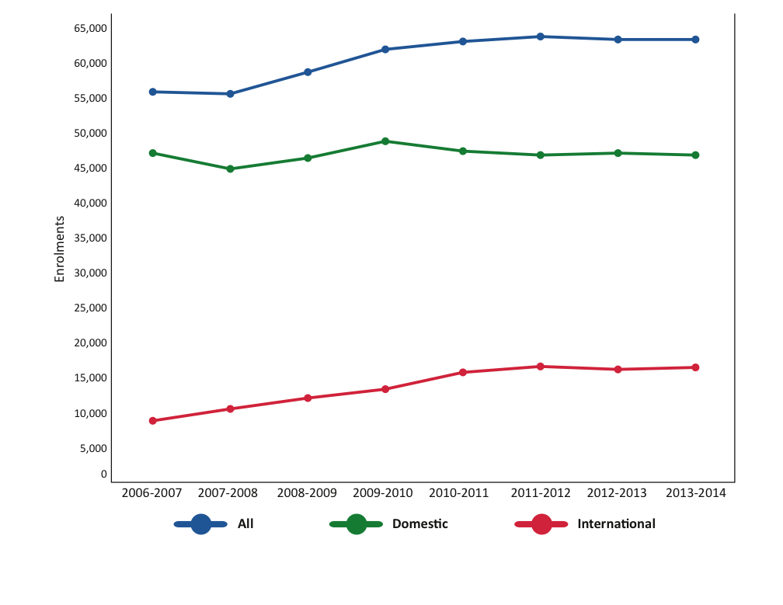
On-Campus Course Enrolments: 2006-2014
Notes:
If you look at the bottom red line, you can see a steady growth of international enrolments. By contrast, the green line shows that domestic enrolments on campus have declined slightly. The overall effect is essentially a plateauing of our on-campus enrolments. The decline in domestic enrolments have been negated by the increase in international enrolments.

Slide 8
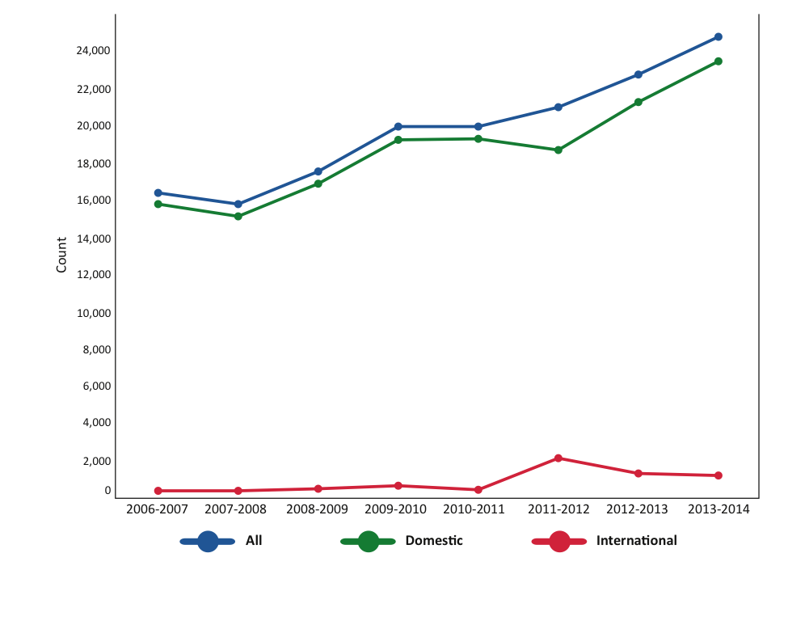
Open Learning Course Enrolments: 2006-2014
Notes:
In open learning, the story is the opposite. Since 2007/08, OL has seen steady growth domestically as evidenced by the green line. Growth in international enrolments in OL, as evidenced by the red line, peaked in 2011/12 and have declined slightly ever since. The overall effect is an overall growth of OL enrolments driven primarily by growth in domestic registrants.

Slide 9
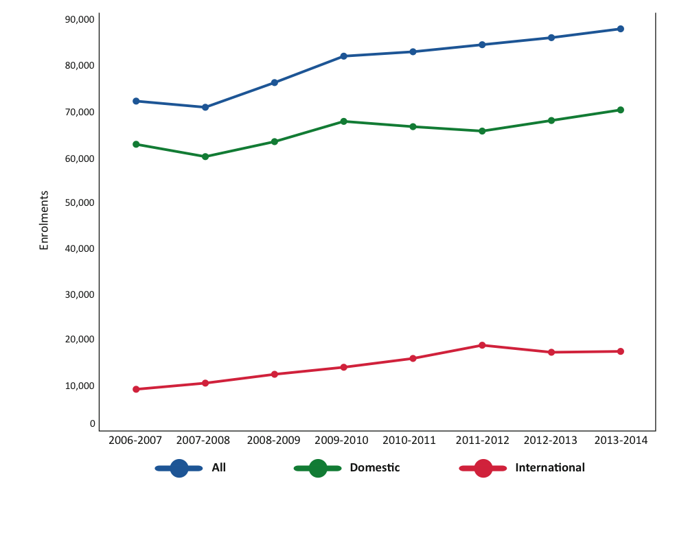
TRU Total Course Enrolments: 2006-2014
Growth Driven By OL/Int’l
Reliance on Int’l Growth is Risky
Notes:
To summarize the previous slides, overall enrolment is trending upwards because of the growth in international enrolments and open learning; offsetting the decline in domestic students on-campus.
International growth has offset the decline in domestic enrolments. Domestic enrolment trends are more predictable and allow institutions more time to adapt to changing conditions. International enrolments on the other hand are risky. As an example, we’ve developed strong markets in the Ukraine and Russia but with the political situation unfolding there, there is a high probability that we won’t see any students from that region (and we were anticipating about 100). Changes in currency, natural disasters, etc all have a bearing and we need to insulate ourselves as best we can against evolving circumstances.

Slide 10
AVED Government Grants ($000’s): 2010-2014
Trend in Declining Grants While Domestic
Enrolment Flat-Lines
Notes:
With those demographic trends in mind, lets look at the pattern of government grant funding. In this graph, you’ll notice that our government grant (in blue) has remained relatively flat while the Routine Capital Grant has been cut by more than 50% since 2010. The University has not been topped up for inflationary costs and with an aging infrastructure, pressures on that infrastructure continue to mount. This is a disturbing trend combined with the fact that we are limited in our ability to increase tuition revenues by the 2% maximum allowable by government.

Slide 11
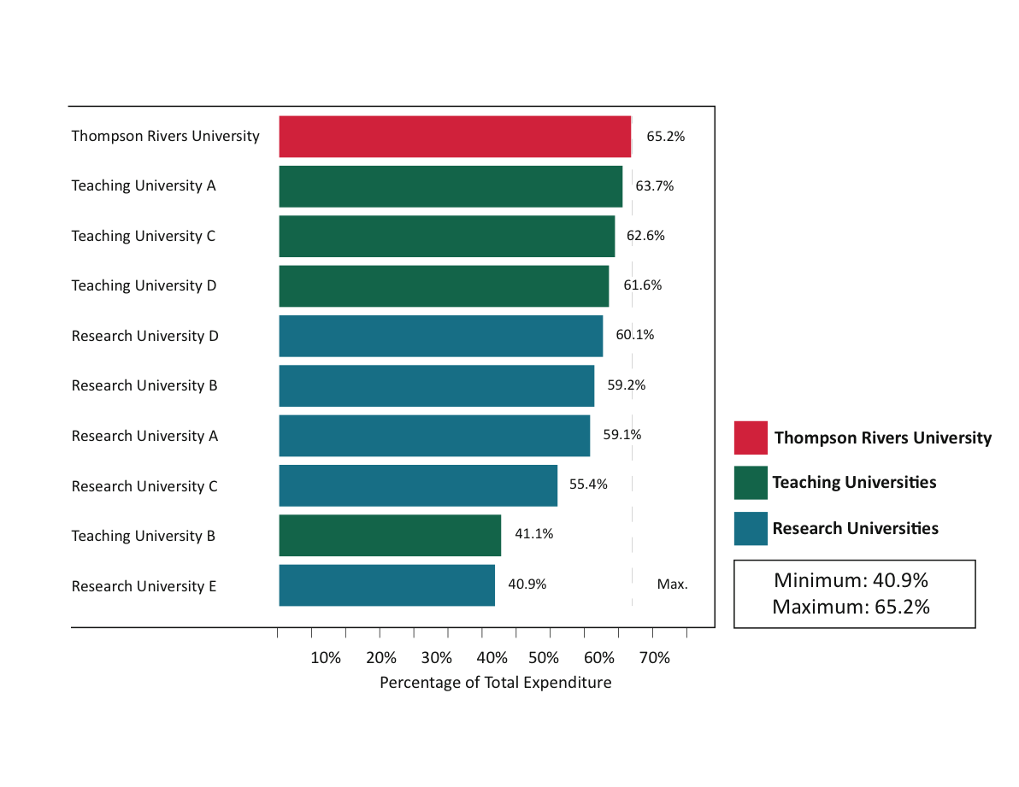
Academic Expenditure CAUBO Comparison
On Campus
Expenditures are as of 2011/12 CAUBO/ACPAU Report Comparison Benchmark Reports prepared by TRU Finance.
Notes:
So with flat enrolments and decreases in revenues, its important we understand how we spend our money.
Many of you have seen these graphs before. These graphs represent a comparison of TRU against BC Research Universities and Teaching Universities.
You’ll see from this, our percentage of total budget spent on academic expenditures (for on-campus students) is the highest in the province at 65.2%. Within this figure, CAUBO includes all costs attributable to academic faculties (the deans, associated deans, teaching costs, operating costs related to those faculties, etc). So I want to be clear this is not just the percentage spent on teaching.
The reason these comparisons are relevant is because all institutions reporting through CAUBO must report the same expenditures in the same buckets. So while we don’t know any one institution’s specific spend on teaching as a percentage of budget, these roll-ups are still apples-to-apples comparisons. Where most institutions spend the highest percentage of their budget on the activity of teaching, its fair to say that the comparison is a relevant and that TRU invests in teaching near the top end of the comparison pool.

Slide 12
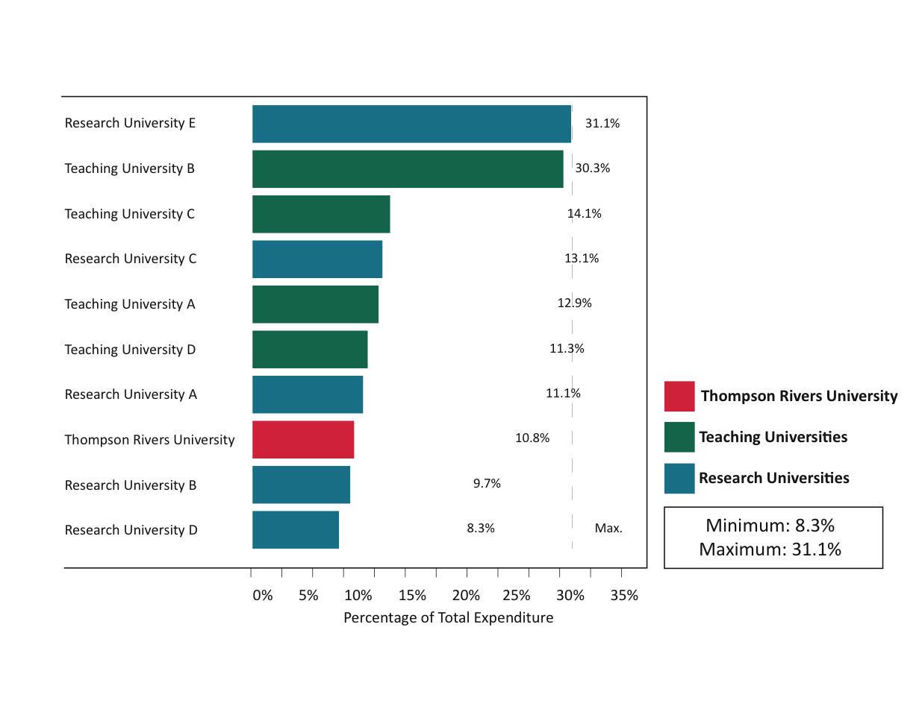
Administration & General Expenditure CAUBO Comparison
On Campus
Expenditures are as of 2011/12 CAUBO/ACPAU Report Comparison Benchmark Reports prepared by TRU Finance.
Notes:
By contrast, our spending on administration (e.g. non-academic administrative labour; financing costs; training and development, etc) is the third lowest in this comparative group.

Slide 13
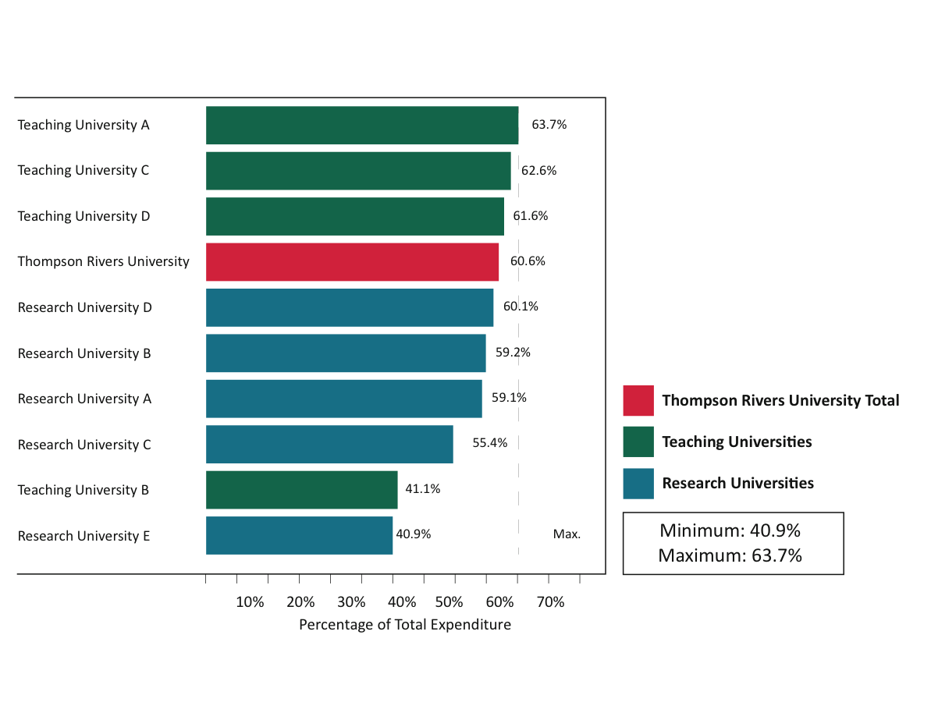
Academic Expenditure CAUBO Comparison
On Campus and OL
Notes:
If we include costs associated with open learning, which is heavy administratively our percentage spend on academics decreases – we’re still the highest ranked RUCBC university but we’re just slightly under 3 of the teaching universities in the province.

Slide 14
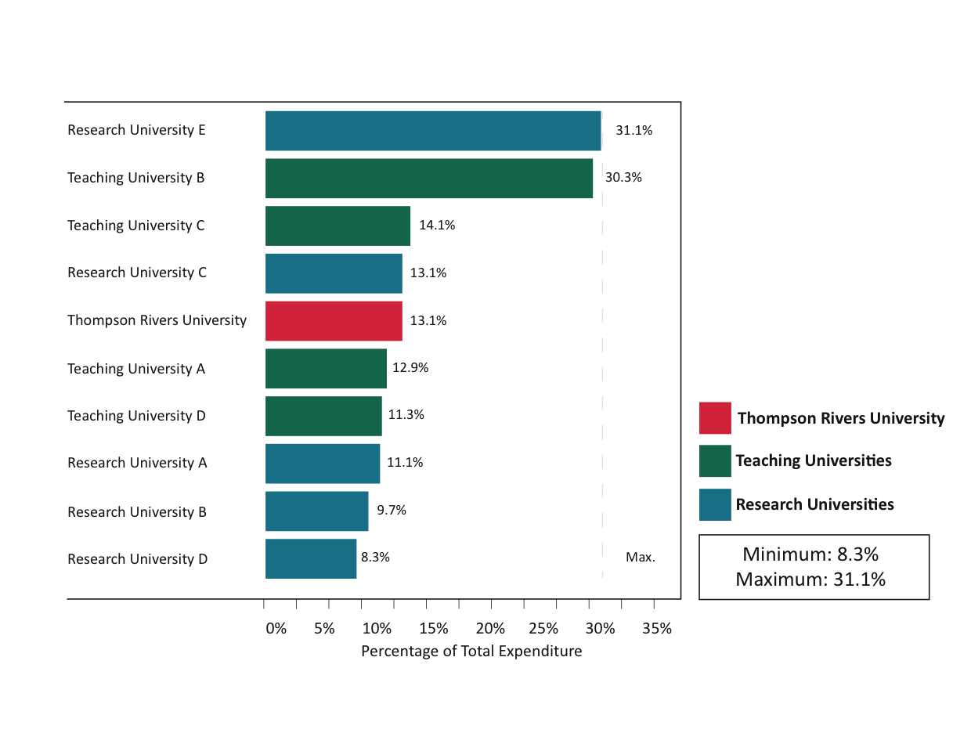
Administration & General Expenditure CAUBO Comparison
On Campus and OL
Notes:
Again, if we include open learning, our overall administrative spend increases slightly ranking us about middle of the pack.

Slide 15
Other Expense Categories CAUBO Comparison
 | ON CAMPUS | RANGE | RANK | OC & OL | RANGE | RANK
Student Services | 11.0% | 2.0-11.4% | 2/10 | 11.3% | 2.0-11.4% | 2/10
IT | 3.1% | 1.2-7.1% | 9/10 | 4.6% | 1.2-7.1% | 6/10
Physical Plant | 5.8% | 5.8-11.7% | 10/10 | 5.4% | 5.4-11.7% | 10/10
Library | 2.7% | 2.7-5.4% | 10/10 | 2.6% | 2.6-5.4% | 10/10
External Relations | 1.4% | 1.4-5.2% | 10/10 | 2.4% | 1.7-5.2% | 7/10

Slide 16
Average Fall Class Size: 2010-2013
Source: BC HEADset Submission
Notes:
So if you consider our academic expenditures; its not surprising that our average class sizes have consistently remained low. This data, taken from the Fall 2013 Space Utilization report shows that in 2013, first and second year classes averaged a class size of 23; and upper year classes averaged a class size of 19.
I should note these are academic class sizes so it excludes developmental and trades activity. For trades the maximum class sizes range from 16 to 18.

Slide 17
Historical Class Size Distribution: 2009-2013
Fall Semester, Kamloops Campus
Note: Compiled from annual internal Space Utilization reports.
Notes:
Considering the average class sizes of 23 for lower year and 19 for upper year; its interesting to note that the average class size falls into the “small class” category.
You can see the definition of small; medium and large classes in the legend below the graph.
What this means is that not only are the majority of our classes in the small category (less than 30); but the average class sizes of 23 and 19 are considerably lower than the small category cap of 29. Given that 36% of our classes are of the medium variety, and 9% are of the large variety, for average class sizes to be 23 and 19 in fall 2013 indicates that there are numerous sections considerably smaller than those averages.
What is also important to note is that by and large, the distribution of class sizes has not changed significantly since 2009.

Slide 18
Course Section Size Breakdown: Small Courses
20% of All Sections <15
Note. Only includes courses for academic credit. Excludes: co-op work terms, thesis courses, directed studies, or distance studies as identified in Banner.

Slide 19
All Employee Wages and Benefits ($’000’s) Relative to Course Enrolments: 2010-2014
Notes:
So lets move to our biggest expense category – employee costs.
The chart shows the trend of employee costs in each employment category. What we see is that the costs are steadily increasing in every employment class even though on-campus enrolments are declining. In 5 years, TRUFA costs have increased by $6.3M; Exempt by $4.5M; CUPE by $4.5M and TRUOLFA by $2M.
At the same time we’ve seen on-campus enrolments drop by 2,027 enrolments; while on-line has increased its enrolments by 5000 enrolments.
In 2014, the total salary cost to teach 1 on-campus enrolment was $892 and the average cost to teach 1 on-line enrolment was $233. Of course, you need to back out of that the TRUFA development costs and trades costs which aren’t captured in our academic enrolments. If you did, that number would be more like $700/OC enrolment
This is not sustainable in an environment where our enrolments are not increasing as fast as our costs..
So lets look at this data another way.

Slide 20
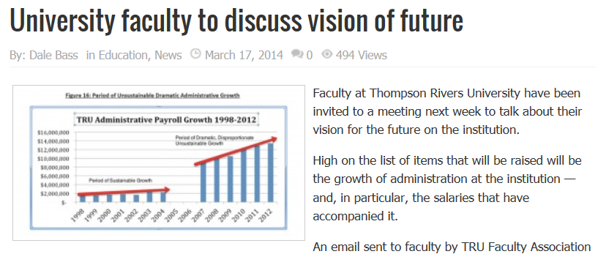
“Period of Dramatic, Disproportionate,
Unsustainable Growth”
Notes:
Some of you may recall this article from the Kamloops Daily news of March 17, 2014. The gist of the article was how administrative spending had gotten out of hand and the University was stockpiling surpluses at the expense of teaching and quality. The graph depicts, to the best of our knowledge, growth of the exempt (or admin) employee category. This graph only showed salary costs…the graph I showed you previously was much bigger because it included total compensation.
So in thinking about the caption – a period of “dramatic”, disproportionate, unsustainable growth”, I had to ask myself…is it?

Slide 21
All Employee Wages and Benefits ($’000’s) Relative to Course Enrolments: 2010-2014
Notes:
So the graph I showed you from the Kamloops this week, correlates specifically to the excluded category as seen here.

Slide 22
Percentage of Employee Category Costs Relative to Total TRU Employee Costs: 2010-2014
 | 2010 | 2011 | 2012 | 2013 | 2014 | 5yr Change
Exempt | 16.4% | 16.8% | 16.9% | 17.8% | 17.8% | 1.4%
TRUFA | 54.9% | 53.7% | 53.6% | 51.8% | 51.9% | (3.0)%
CUPE | 24.8% | 25.4% | 25.1% | 25.6% | 25.0% | 0.2%
TRUOLFA | 4.0% | 4.2% | 4.3% | 4.8% | 5.3% | 1.3%
TEACHING | 58.9% | 57.8% | 58.0% | 56.7% | 57.2% | (1.7%)
NON-TEACHING | 41.1% | 42.2% | 42.0% | 43.3% | 42.8% | 1.7%
Notes:
So let’s answer the dramatic, disproportionate, unsustainable growth question. This table shows the % of total compensation spent in each of the employment classes.
You’ll see since 2010, the exempt category has increased by 1.4%; CUPE has increased by 0.2% and TRUOLFA has increased by 1.3%. During that same period, total spending as a percentage of compensation budget has decreased by 3.0% in TRUFA.
If you take the universities teaching costs as an aggregate, you’ll see that the % spent on teaching has declined slightly by 1.7% and the increases in non-teaching have increased by the corresponding amount. But again, in real dollar terms, all employee categories have increased.
Is this dramatic…no. Is it disproportionate – no. Actual dollars spent in each employee class have increased whereas the amounts spent as a percentage of budgets have changed only slightly so there’s nothing dramatic or disproportionate in any of these findings. However, with respect to the question of sustainable, given how our enrolments are trending, these trends are not sustainable and we need to really begin to question our costs in all areas of the university.

Slide 23
Employee Headcounts: 2010-2014
 | 2010 | 2011 | 2012 | 2013 | 2014 | 5yr Change
Exempt | 137 | 149 | 160 | 172 | 156 | 12.2%
TRUFA | 433 | 421 | 410 | 413 | 404 | (6.7)%
CUPE | 349 | 346 | 344 | 355 | 362 | 3.7%
TRUOLFA | 128 | 133 | 186 | 195 | 193 | 50.8%
TEACHING | 53.6% | 52.85 | 54.2% | 53.6% | 53.5% | (0.1)%
NON-TEACHING | 46.4% | 47.2% | 45.8% | 46.4% | 46.5% | 0.1%
Notes:
We’ve looked at the proportions from a financial perspective so lets explore them from an employee headcount perspective.
Is this dramatic…no. Is it disproportionate – no. Actual dollars spent in each employee class have increased whereas the amounts spent as a percentage of budgets have changed only slightly so there’s nothing dramatic or disproportionate in any of these findings. However, with respect to the question of sustainable, given how our enrolments are trending, these trends are not sustainable and we need to really begin to question our costs in all areas of the university.

Slide 24
Excluded Wages and Benefits (‘000’s): 2005-2014
The Moment The World Changed
Notes:
One other quick observation that was made when we did the analysis is that we took the total compensation for the exempt category and we graphed the costs of the employees based on where they were assigned.
So you can see that we’ve split out the academic divisions (which includes library, student services, reg office, faculties, provost, etc) open learning division, law, etc.
What’s interesting is you can see a distinct change in spending behaviour at the time of the current budget methodology was installed. What happened here is that the operating budget of the administrative units were increased and budget managers spent to the level of those increases and basically maintained that level of spend over time since their budgets didn’t change substantially. On the academic side, we see a steady increase in administrative spending because Deans now had the ability to spend as their tuition revenues grew. There are other factors here of course but the timing of this change in spending patterns is really interesting and in some ways speaks to how the current budget methodology gave budget manager the ability to spend on whatever they felt was important because they had the resources to do so.

Slide 25
Average Salary by Employee Group: 2010-2014
Average Salary in all Employee
Categories is Increasing
Notes:
This chart shows how the average salary of an employee in each category has changed over the past 5 years.
Taken together, the average salary of all employees has increase 9.85% since 2010.
By employee category; the average exempt salary has increased by 7%; the average TRUFA salary increased by 11%; the average CUPE salary increased by 10% and the average TRUOLFA salary increased by 13%

Slide 26
Employee Category Salary Increases: 2010-2014
 | 2010 | 2011 | 2012 | 2013 | 2014
General Wage Increase
Exempt | 2.0% | 0.0% | 0.0% | 0.0% | 0.0%
TRUFA | 2.5% | 0.0% | 0.0% | 2.0% | 2.0%
CUPE | 2.0% | 0.0% | 0.0% | 2.0% | 2.0%
TRUOLFA | 3.0% | 0.0% | 0.0% | 2.0% | 2.0%
Progression Through the Scale
Exempt | 0.0% | 0.0% | 0.0% | 0.0% | 0.0%
TRUFA | 3.0% | 3.0% | 3.0% | 3.0% | 3.0%
CUPE | 0.0% | 0.0% | 0.0% | 0.0% | 0.0%
TRUOLFA | 0.0% | 0.0% | 0.0% | 0.0% | 0.0%
Notes:
When you look at the employee category collective agreement increases; the previous slide begins to make more sense.

Slide 27
Employee Category Average Salaries: 2010-2014
 | 2010 | 2011 | 2012 | 2013 | 2014 | 5 Yr Change
Exempt | $82,918 | $85,566 | $86,211 | $86,103 | $88,916 | 7.2%
TRUFA | $79,312 | $81,489 | $83,176 | $84,428 | $88,402 | 11.5%
CUPE | $43,511 | $43,288 | $44,302 | $46,804 | $48,060 | 10.5%
TRUOLFA | $20,286 | $21,753 | $17,656 | $19,486 | $22,905 | 12.9%
Notes:
When you look at the employee category collective agreement increases; the previous slide begins to make more sense.

Slide 28
Annual Surplus: 2010-2014
Annual Surplus Trending Downward

Slide 29
5 Year Annual Trend: Accumulated Surplus
Accumulated Surplus Trending Upward

Slide 30
Accumulated Surpluses ($‘000’s): 2010-2014
 | 2010 | 2011 | 2012 | 2013 | 2014
Invested in Fixed Assets | $14.7 | $15.5 | $21.3 | $30.8 | $36.0
Internally Restricted | $20.5 | $21.2 | $30.7 | $24.1 | $25.4
Restricted for Endowments | $0.7 | $0.7 | $0.7 | $0.7 | $0.7
Accumulated Remeasurement Gains/Losses | $0.0 | $0.0 | $0.0 | $0.4 | $(0.1)
Unrestricted Surplus | $9.4 | $16.6 | $18.6 | $19.7 | $17.3
Accumulated Surplus | $45.3 | $54.0 | $71.3 | $75.7 | $79.3
Notes:
When you look at the employee category collective agreement increases; the previous slide begins to make more sense.

Slide 31
Interest Income: 2010-2014
Redistributed in the Block Grant

Slide 32
ACT 2:
INTRODUCING A NEW METHODOLOGY

Slide 33
WHY CHANGE THE MODEL?
No ability to fund institutional strategic initiatives
No ability to fund certain known institutional costs
Need to review how we spend our limited resources
Block grants to faculties/units have remained largely unchanged since 2007
Management practices inconsistent with
an enrolment-based model
Leaving too much cash on the table at year-end
Creates disincentives for collaboration between units/faculties

Slide 34
WHAT WORKS IN THE CURRENT METHODOLOGY?
Contributes to TRU’s surplus
Rewards growing Faculties
Budget allocations pre-determined so minimizes administrative work
Allows for significant freedom of management decisions
Encourages entrepreneurial activities

Slide 35
PROCESS CHANGE DRIVEN BY GUIDING PRINCIPLES:
“Managers of financial resources at TRU are expected to make budgetary decisions that are in the best interest of TRU as an institution”. Source: Guiding Principles for a TRU Budget Methodology – Adopted by BCOS, February 2014
Strategically driven
Transparent, deliberate, consultative
Sustainable
Mitigate risks
Encourage entrepreneurship, innovation and efficiency
Supportive of a common TRU
Simple

Slide 36
PROPOSAL FOR AN UPDATED METHODOLOGY:
Proposed model is a hybrid model
Based on a modified zero-based budgeting methodology with clearly defined elements of performance-based budgeting that aligns with current strategy
Zero-based budgeting in its pure form means that all costs must be justified every year; modified zero-based budgeting means, in this context, that continuing employee salaries and benefits will not be zeroed out but workloads will be optimized
Performance-based budgeting in this context anticipates that units will be rewarded for achieving against specific metrics
Proposed methodology tentatively called the
FY2015/16 TRU Budget Methodology

Slide 37
HOW DOES THE 2015/16 TRU METHODOLOGY WORK?
Step 1: Zero-out budgets
Step 2: Forecasting revenue
Step 3: Creating the TRU Strategic Investment Fund (SIF)
Step 4: Developing service plans
Step 5: Update faculty/unit risk registries
Step 6: Base-fund known operational costs
Step 7: Base-fund permanent, ongoing employee costs
Step 8: Optimizing employee expenditures
Step 9: Optimizing operating expenditures
Step 10: Budget submissions/review/approval process

Slide 38
TIMELINE
September: Revenue forecasts and expense assumptions completed; Central revenue pool determined; KPI Incentives determined (if any); SIF percentage determined; Budget submission packages are released; Administration meets with TRUSU to discuss perceived service gaps
November: Faculties/units complete work load plans for VP approval; Risk registries submitted to Enterprise Risk Management Committee for review and prioritization; Budget Managers discuss SIF proposals with VP’s for approval for inclusion in budget submissions
December: Faculties/Units submit completed budget packages with SIF and operating expense justifications; ERM committee submits its priorities for risk mitigation funding

Slide 39
TIMELINE continued…
January: Budgets submissions are reviewed by the President’s budget committee
February: Draft budget is presented to BCOS for recommendation for approval
March: Budget presented to Senate; Budget approved by the Board and budget letters released to Faculties/Units
May: Budget post-mortem. Schedule for zero-base reviews
will be determined.

Slide 40
WHY THIS PROPOSED METHODOLOGY?
Fully aligns with guiding principles
Considers all revenues to be University revenues
Effective way of controlling unnecessary or non-strategic costs since all costs must be justified in each budget cycle
Encourages optimal work-force planning
Aligns resource allocations with service expectations
Allows for strategic investment through resource redistribution
Respects TRU’s collective agreements

Slide 41
GUIDING PRINCIPLES - CURRENT VS PROPOSED
GUIDING PRINCIPLE | CURRENT | PROPOSED
Strategically Driven | NO – no mechanism to invest in institutional priorities | YES – Creation of a Strategic Investment Fund tied to strategic plan
Transparent, Deliberate, Consultative | NO - Pre-determined; makes consultation difficult | YES – Clearly defined process; service plans define service levels; allows for input
Sustainable | NO - fixed methodology; costs never scrutinized | YES - Dynamic – costs reviewed annually
Mitigates Risk | NO - No money budgeted to mitigate institutional risks | YES – Links risk registry with budget process

Slide 42
GUIDING PRINCIPLES - CURRENT VS PROPOSED
GUIDING PRINCIPLE | CURRENT | PROPOSED
Encourages Innovation, Entrepreneurship and Efficiency | YES/NO – “Spend what you earn”; encouraged spending what was earned | YES – Incentives provided through business cases and KPI’s;
Supportive of a Common TRU | NO – Created a sense of “ownership” by the earner of the dollar | YES – A dollar earned from a TRU activity is a TRU dollar first
Simple | YES/NO – Pre-determination of allocations; complexity in carry-forward rules and other “deals” | YES – Process will be clearly defined and communicated; IT WILL BE MORE WORK

Slide 43
ENCOURAGING INNOVATION AND ENTREPRENEURSHIP:
Project Funds: Money will be provided, based on solid business cases, for projects that enhance the strategic priorities of the institution or have a defined and reasonable payback period (can be on a short or long term basis); could include funding projects/positions in other areas
Continuing Education/Graduate Programs: Revenues earned from continuing education can flow to the source directly less a defined overhead component
Specific deliverables: Over achieving against pre-defined key performance indicators (e.g. retention, enrolment targets, etc) could yield specific rewards. Specific deliverables may change on an annual basis depending on need or strategic direction

Slide 44
ADDITIONAL INFORMATION:
Road Map for a New Budget Methodology at TRU,
Discussion Paper available at:
http://www.tru.ca/budget
Feedback/Thoughts/Ideas: mmilovick@tru.ca

Slide 45
ACT 3:
QUESTION PERIOD

